Slide 1



RAKESH GLASS & PLYWOODS ELEVATING INTERIORS WITH A DIGITAL PRESENCE
PROJECT GUIDE
Dr.M.VIMALADEVI
ASSOCIATE PROFESSOR/AI
PROJECT MEMBER
PADMAPRIYA R – 22ALR063
RASHMIKA K R – 22ALR076
RITHIK CHANDRASEKAR – 22ALR081

Slide 2
COMPANY DETAILS
SHOP NAME : Rakesh glass and plywood
SHOP OWNER NAME : Rakesh
MAIL ID : rakeshkgm23@gmail.com
ADDRESS : 28-c nandhini complex kovai road kangeyam -638 701
PHONE NUMBER : 9944962351,9952179391

Slide 3
PROBLEM STATEMENT
The plywood and glass industry faces challenges like inventory mismanagement, inaccurate stock tracking, delayed orders, and limited online presence. With diverse products such as plywood, glass panels, and laminates, real-time stock visibility and efficient customer engagement are crucial. Manual processes often lead to stock mismatches, missed sales, and operational inefficiencies, highlighting the need for a digital solution.

Slide 4
OBJECTIVE
Enhance Online Presence
Create a professional website for better accessibility.
Streamline Product Display
Organize and categorize products for easy browsing.
Improve Customer Engagement
Enable inquiries and contact forms.
Optimize Business Operations
Provide location, contact details, and working hours.
Boost Sales & Visibility
Increase brand awareness and attract customers.

Slide 5
MODULES USED
User Authentication Module
Secures admin access using JWT-based login/logout.
Manages user roles and protected routes.
Stores credentials securely with hashed passwords.
Customer Enquiry Management Module
Captures enquiry details via frontend forms.
Stores data in MongoDB for easy admin access.
Enables tracking and response to customer queries.
Product Catalog Module
Organizes products by categories with details and images.
Allows customers to browse and request quotes.
Admin can add, update, or remove product listings.

Slide 6
MODULES USED
Content Management Module
Admin can edit homepage text, product info, and business details.
Makes website content dynamic and updatable without code.
Supports future scalability for more sections.
Contact & Location Module
Displays address, phone, email, and business hours.
Embedded Google Map for navigation support.
WhatsApp chat integration for direct communication.

Slide 7
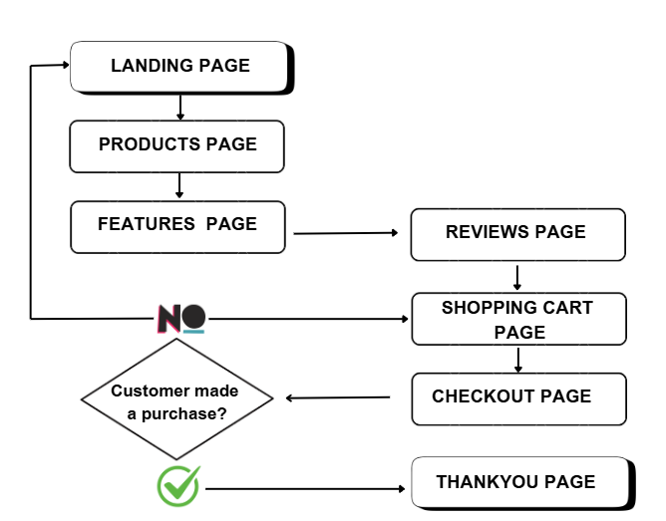
PROJECT OVERVIEW

Slide 8
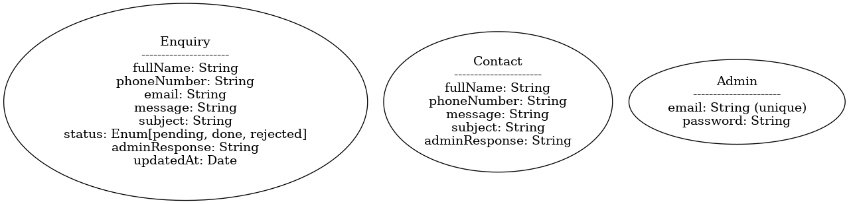
MONGODB SCHEMA OVERVIEW

Slide 9
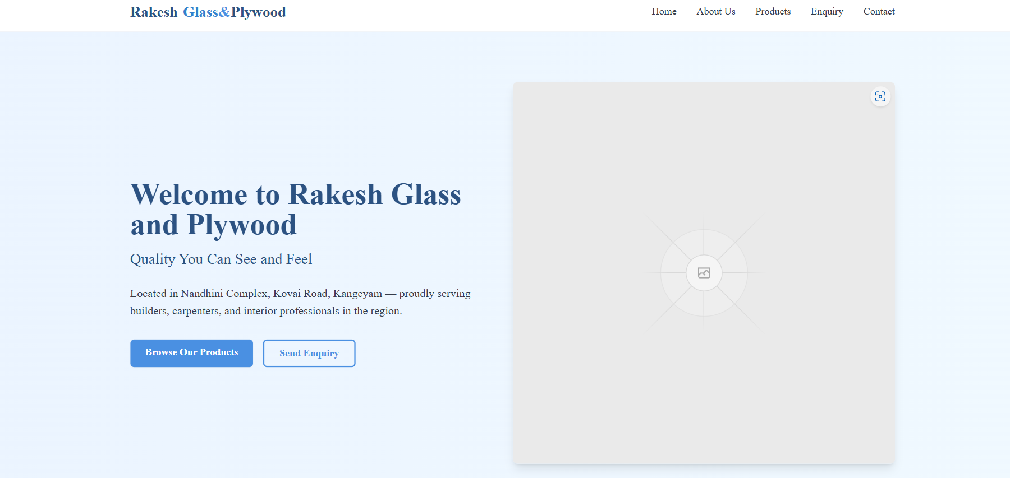
PROJECT IMPLEMENTATION SCREENSHOTS

Slide 10
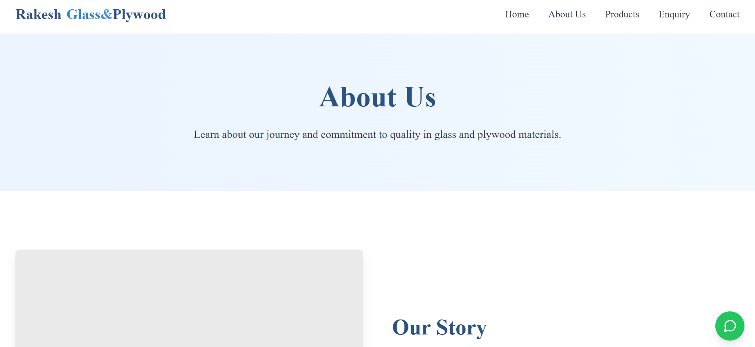
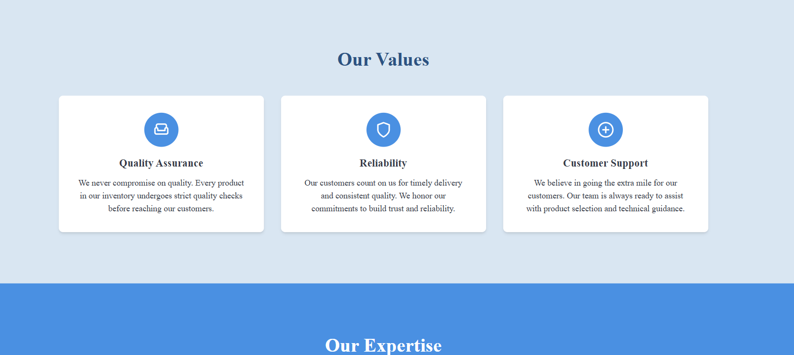

Slide 11
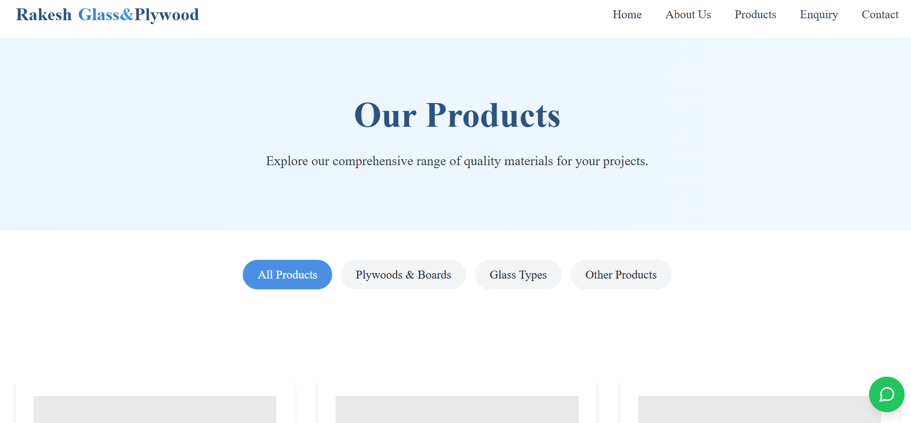

Slide 12
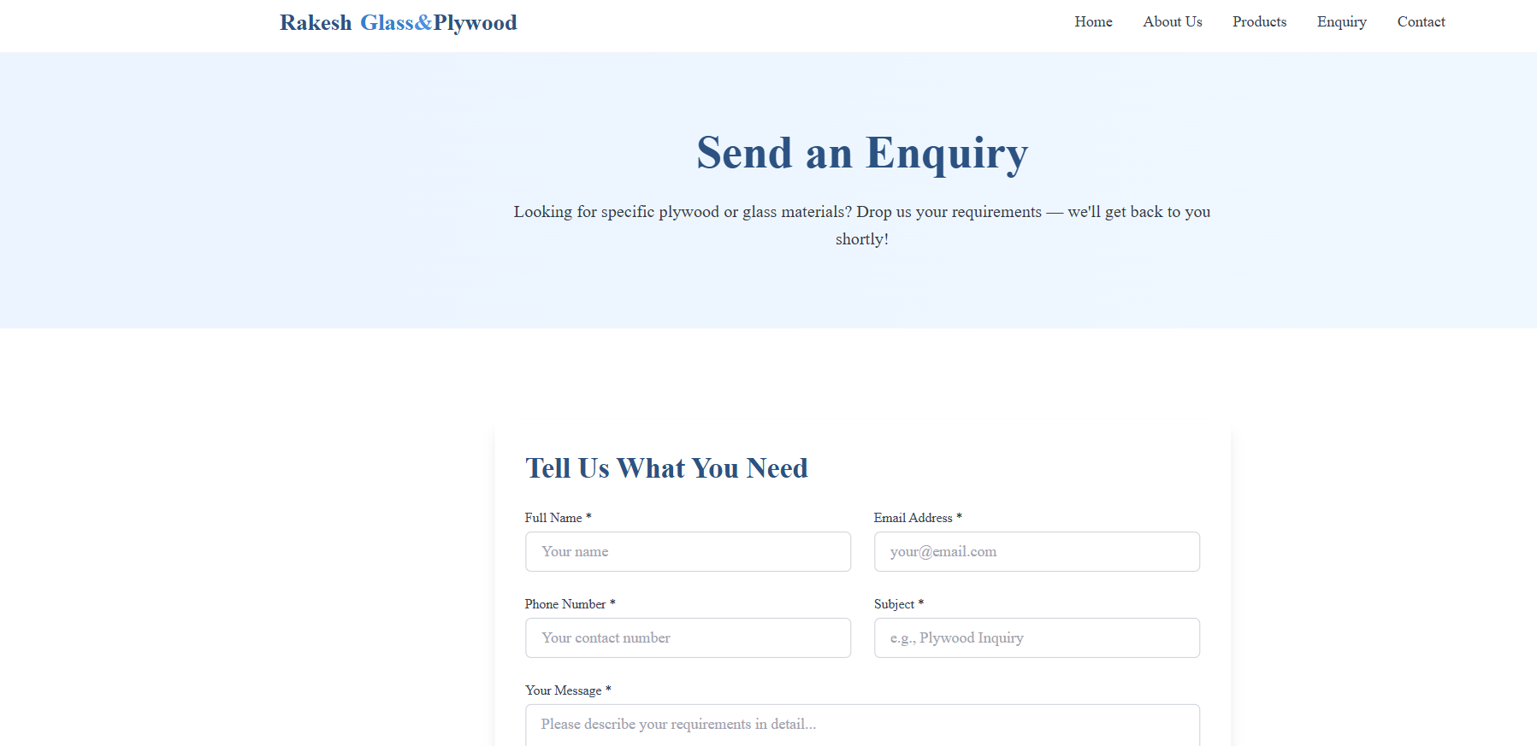

Slide 13
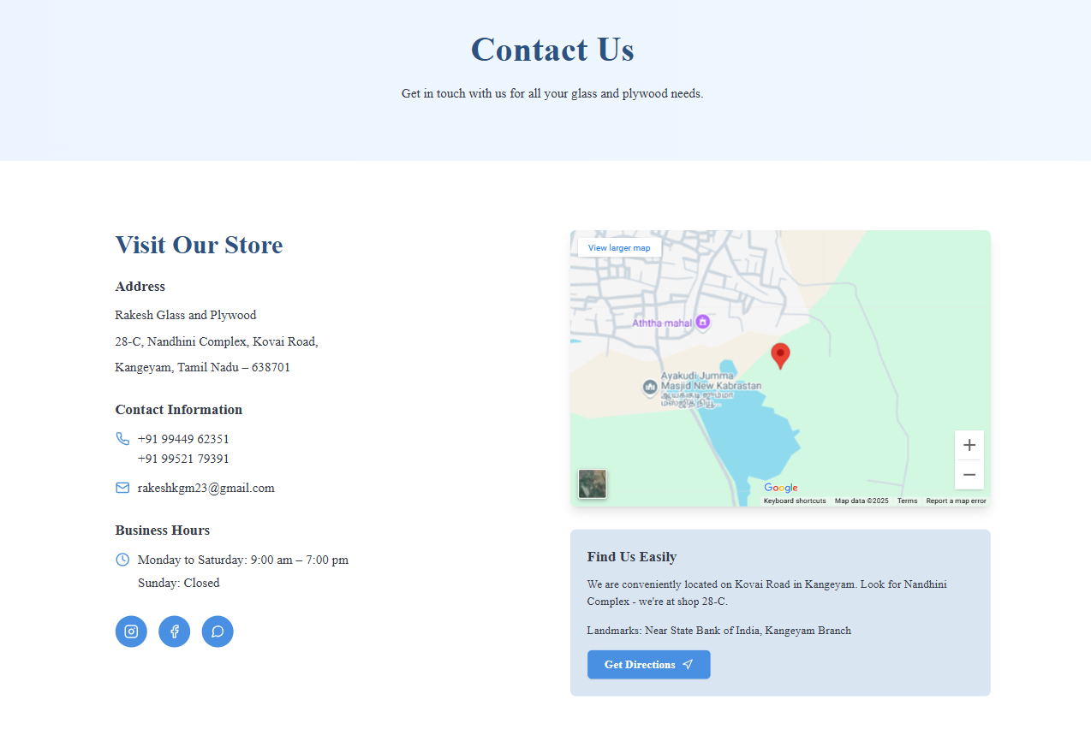

Slide 14
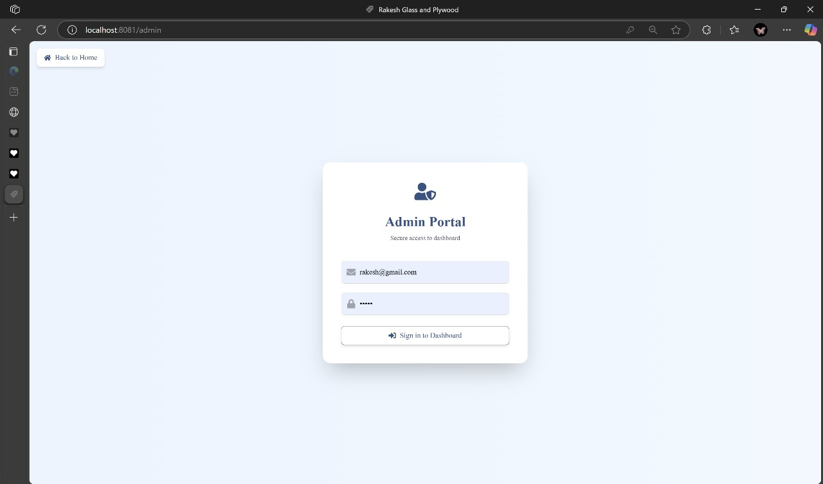

Slide 15
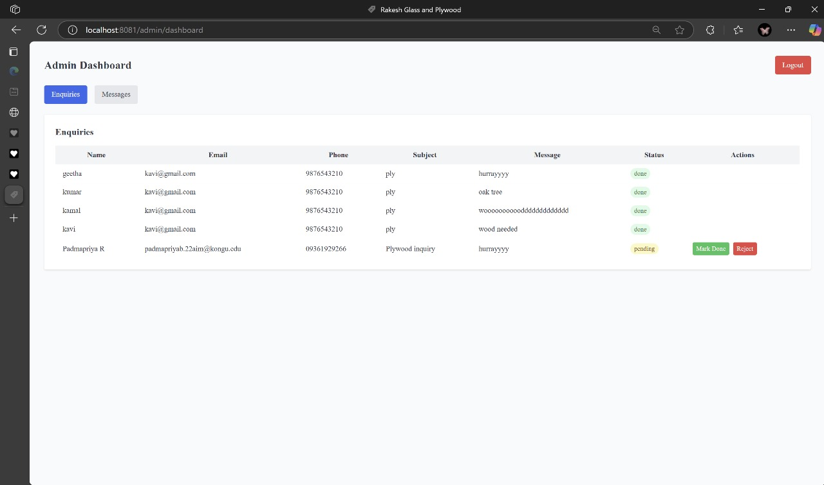

Slide 16
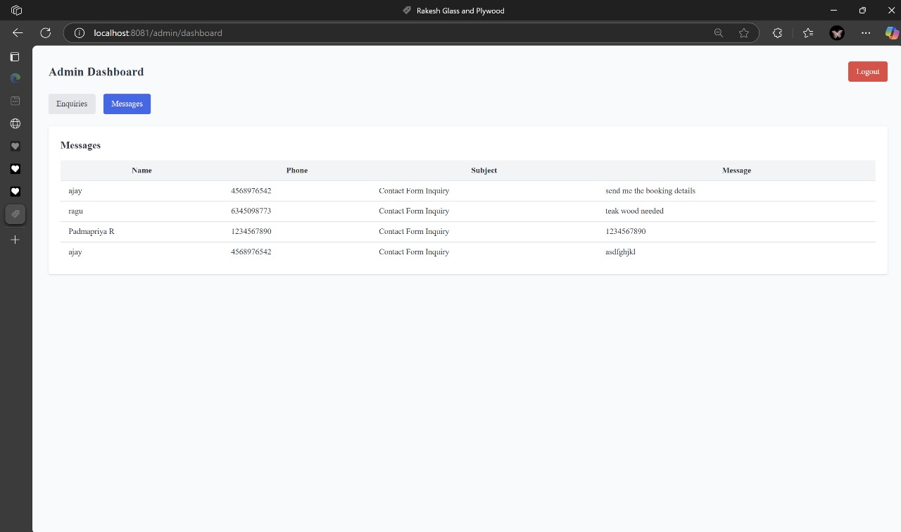

Slide 17
LITERATURE SURVEY
Developing an Inventory Management Application Using MERN Stack – Lubna Rasel (2024) Focuses on building inventory systems with MERN stack.
Web-Based Online Inventory Information System– Soegoto & Palalungan (2020) Discusses web-based inventory systems for business efficiency.
Inventory Management System – IJCRT.org (2022) Explores MERN stack for scalable inventory solutions.
SMRT Inventory Management System– IJNRD (2024) Highlights real-time data processing in inventory systems.
An Improved Web-Based Inventory Management System – EUDL (2023) Addresses challenges like overstocking in web-based systems.

Slide 18
THANK YOU

